Slide 1
Curve Fitting With 1-Dimensional
Self Organizing Feature Map
Term Project by ***

Slide 2
Index
Paper Summary
  D. Amitava & S.K. Pauri, Skeletons from dot patterns : A neural network approach,Pattern Recognition Letters, vol.18,1997,pp335-342
Experiment Result
Summary

Slide 3
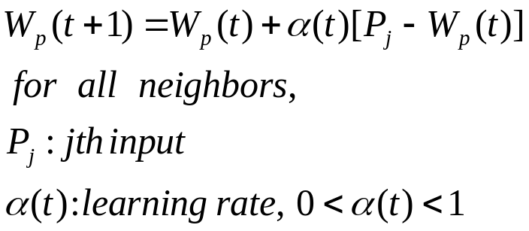
Basic Idea
Purpose
  Find underlying structure in character image using SOFM
  Adaptively search for Optimal Number of nodes
Elements
  Basic Structure : 1-D SOFM ( Peano Curve )
  Weight Update : Kohonen’s Learning Rule

Slide 4
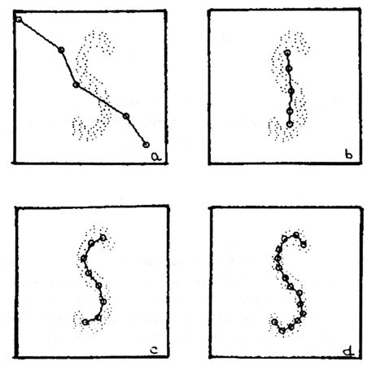
Algorithm
1. Initialize Curve
2. Converge curve using Kohonen’s
Learning Rule
3. After convergence, analyze curve & modify structure
- merge 2 node if too close
- insert a new node if too far
- make a new branch
4. Repeat until no structure change take place
initial
19th Epoch
86th Epoch
261th Epoch

Slide 5
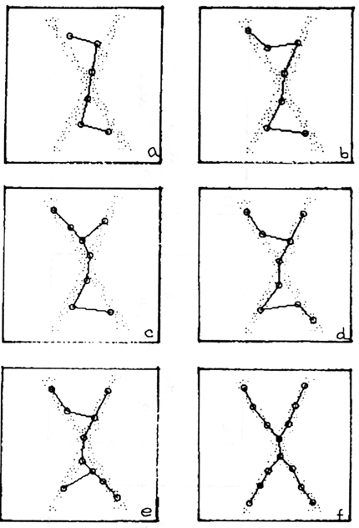
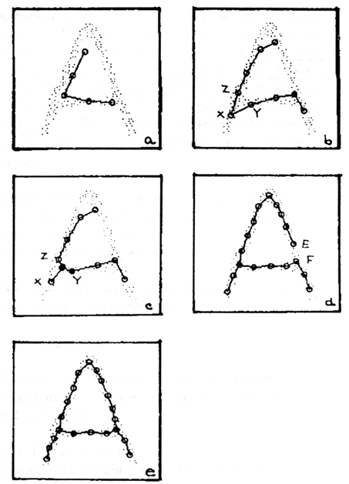
Examples

Slide 6
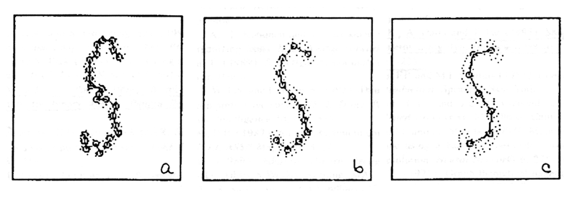
Pros / Cons
Pros
  find structure without edge info
  robust to salt noise
Cons
  slow processing speed
  threshold for nodes should set manually

Slide 7
Document Clustering with Kohonen feature Map
Term Project
  By ***

Slide 8
Introduction to Kohonen Map
SOM(Self-organizing map)
Unsupervised learning paradigm
Procedure
  Inputs are presented to the input layer
  The distance to the input to the weights are computed
  Winner is the output closest to the input
  Adjust the weights of winner
  Repeat above process.
As a result
  we can get a feature map
Adjust weights of winner and
units in the Neighborhood
toward the input Pattern
Inputs
Output units
complete
Winner is the unit
‘closest’ to input

Slide 9
Introduction to this Project
Document clustering with Kohonen Map
Minimal Spanning Tree Generation from the output
  The closest out units are linked
  Then the minimal spanning tree can be generated
Kohonen Map
Input
Documents
Output

Slide 10
Method (1/2)
Document clustering with Kohonen Map
  Document vector: term frequency vector (f₁, f₂, f₃, …, f_{m})
    Term Extraction: Bigram (ex: 김진숙 -> 김진 진숙)
  Input Vector
    Doc. vector dimension, m was reduced to input dimension, N.
      m = 10,632,
      N = 50, 100, and 200 were chosen arbitrarily.
    Document to Input vector transformation
  Output units(map size): 15x15, 10x10, and 5x5 were used.
Term Freq. Vector: (f₁, … f_{m/N}, f_{m/N+1} … f_{2m/N}, f_{2m/N+1}, ... f_{m})
Σ
Σ
Σ
Input Vector: (x₁, x₂, … x_{N})

Slide 11
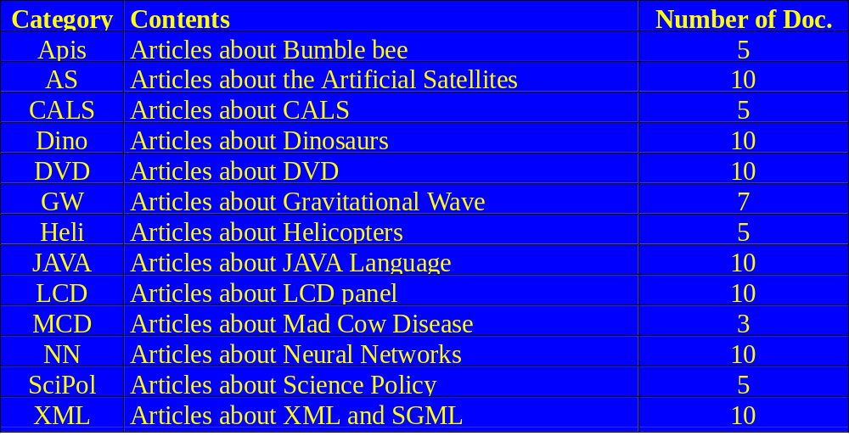
Method (2/2)
Input Documents
  100 articles selected from a document database with 1 or more keyword(s)

Slide 12
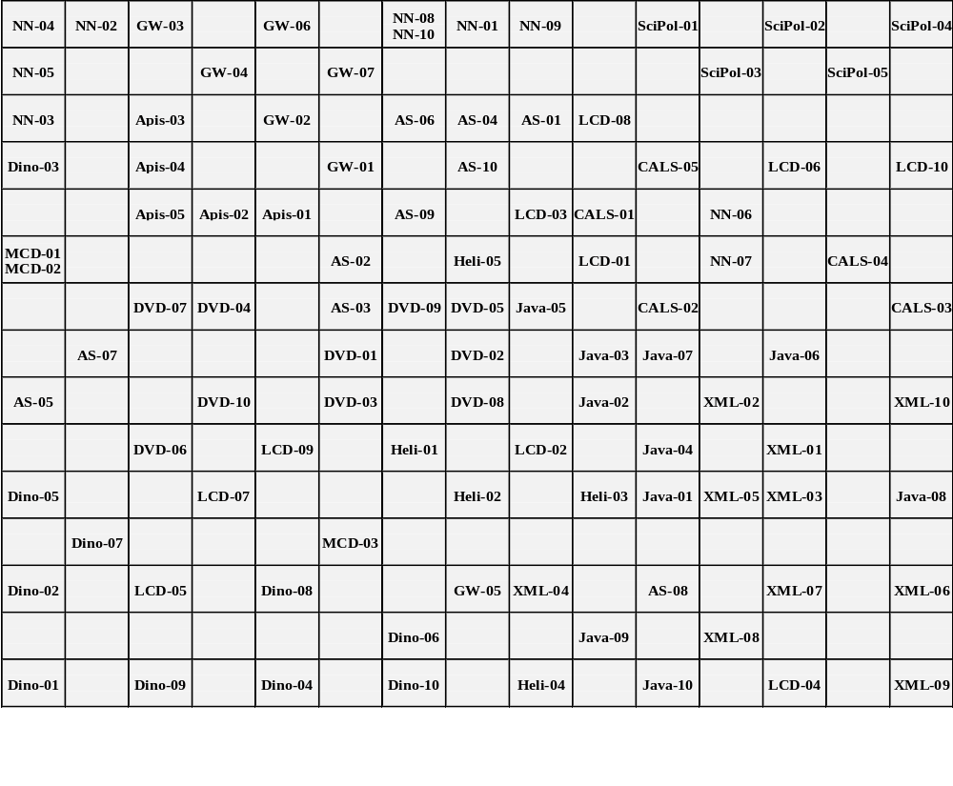
Result (N=200, map=15x15)

Slide 13
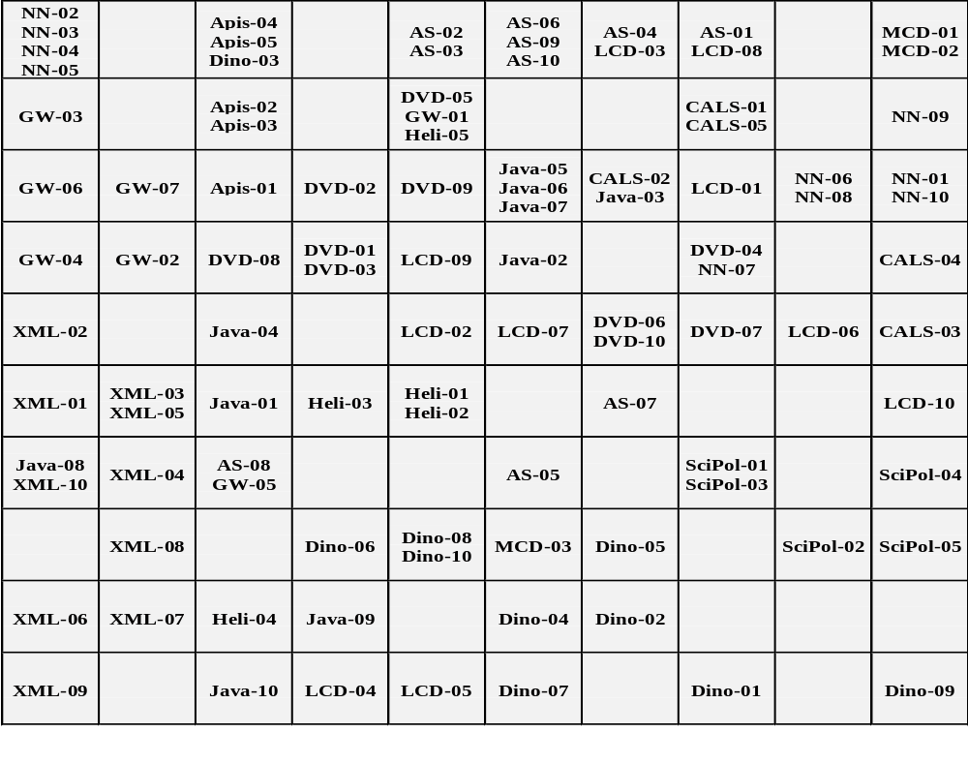
Result (N=200, map=10x10)

Slide 14
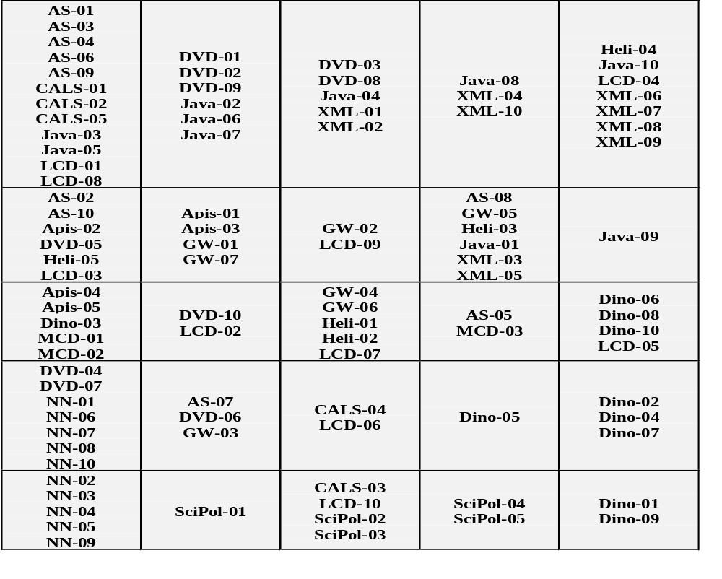
Result (N=200, map=5x5)

Slide 15
Minimal Spanning Tree
Each output unit has the closest neighbor.
Then we can build a minimal spanning tree from the feature map generated by the network.
Part of the tree is shown on the right. (adapted from the result of mapsize 15x15)
MCD01
MCD02
MCD03
Apis02
Apis01
Apis04
Apis03
Dino05
Apis05
Java05
Java06
Java03
XML02
• • • • •

Slide 16
Conclusion
Document clustering with Kohonen Map
  Arbitrary document set can be clustered with respect to their contents.
Minimal Spanning Tree Generation
  From the Euclidean distance among the output units, we can build a minimal spanning tree with respect to their closeness of the documents.
  Minimal spanning tree showed the additional relationship between distant output units.

